Slide 1

Basic Details of Problem Statement and Team
Problem Statement Title:: Developing a website that Helps tracking and Monitoring the illegal activities on Dark Web.
Team Name: Cod-O-Maniacs
Team Leader Name: Vishu Bhati
Registration ID : 1773
Institute Name: Poornima College Of Engineering , Jaipur
Theme Name: Dark Web Monitoring

Slide 2




Our Esteemed Team Members and their roles
Vishu Bhati
(Team Leader) Role – Presenter
Programmer
PPT creator
Kumar Vatsalya Rahul Role – Presentation Creator
Sahil Agarwal Role – Content Creator
Nityam Kumar Role – Website Interface Creator

Slide 3
Points Covered
Dark Web Characteristics
Data Leak Recovery
Threat Intelligence and Analysis
Integration with Incident Response and cyber security infrastructure
Why Monitor Dark Web?
Idea/Approach Details
Working of our website “Pro-Tekk”
Software and Programming Language Used
Future Plans

Slide 4

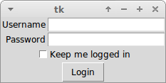


Dark Web Characteristics
Protected by authentication layer or paywall
Not referenced by search engines whatsoever
Not linked from other pages.

Slide 5
Data Leak Recovery
Once threats are found – be the credential list , swaths of card numbers , pii of executives , or something else – working with professionals dark web experts to recover, it can limit the damage and dole out to the enterprise.
Dark web is too dangerous to go out alone out there. As per many websites , it’s a must to not to engage cyber criminals own your own. Those with extensive Hands-on experience dealing with the dark web should lead out on these engagements , diving deep with the right level of precaution and expertise. Chasing down savvy threat actors in the criminal underground requires extensive depth and must be done with the right access , experience , context and reputation to avoid doing more harm than good. It’s necessary to find an external cyber-security provider with right expertise and let the dark web analyst clear the way on these covert operations.

Slide 6
Threat Intelligence and
Analysis
Your overall strategy is only as good as your basis of threat intelligence and analysis. Simply put , a top-tier monitoring solution needs to consistently provide an analyzed data on digital threat actors , Emerging threats and a range of online threats that lurk between deep and the dark web.
Dark web threat intelligence is critical as the dark web has become a hot-bed for cyber crime and safe heaven for threat actors looking to trade stolen data , traffic malicious scripts and software , and plot future cyber attacks. The right intelligence can’t only deliver early warning of impending threats , but also covertly discover mentions of your brand , locations, and people across hidden channels. The bottom line is that good cyber threat intelligence speeds up decision making for security leaders, making a monitoring tool and invaluable threat mitigating resource.

Slide 7
Integration with Incident Response and Cybersecurity
Infrastructure Integration
with Incident Response and Cybersecurity Infrastructure
Lastly, one of the most important things to consider when choosing a Dark Web monitoring solution is its ability to integrate seamlessly into the security architecture you already have. The more partners and integrations, the greater an organization's chances of adoption and success. On the incident response front, an enterprise-worthy monitoring tool should deliver results end-to-end. As companies grapple with not just detecting but neutralizing Dark Web threats, an efficient incident response mechanism can facilitate a prompt, decisive counteraction, reducing both cost and incident impact.

Slide 8
Why Monitor Dark Web ?
Dark web is the home to many illegal activities such as Cybercrime , Drug dealing , Arms dealing , Money Laundering , cryptocurrency frauds, censorship resistance , etc. Many Crime Syndicates openly use dark web to let their crimes run wild over a full throttle since they know that it’s not easy to enter dark web. It’s extremely infuriating to see such crimes run wild. So, in order to stop these crimes once and for all , it gives rise to the dark web monitoring. Dark web monitoring, also known as Cyber-Monitoring, is a service that searches the dark web for stolen user credentials and personal and financial data available on the web. It uses automated scanners, crawlers, and scrapers to locate stolen credentials on public sites.

Slide 9
Idea / Approach Details
The dark web is part of
internet that isn't visible to search engines and requires the use of an anonymizing browser called Tor to be accessed. So, in order to resolve these problems and reducing crime-rates , We are creating a website to track and monitor the activities of Dark web which will track the IP address of the logged in devices and also track the location of every single device that has entered the dark web.

Slide 10
Working of Our Website “ Pro-Tekk”
1.) First , the government can visit our website by typing the URL --> www.pro-tekk.gov.in , since we’ll link our website with our government website.
2.) After that , You’ll be directed inside the interface of Dark web as we’ll directly link dark web with our website to remove the hassle of entering dark web. 3.) Then , on the same interface , you’ll get different types of buttons like Track IP address of logged-in devices , Logged-in devices , Location of Logged-in devices. 4.) You can choose any of the operations to track the devices using dark web in respective manner.

Slide 11
Software and Programming Languages
used
Frame Work → HTML Tracking → IP address and Device Location Monitoring → Device Location , Python

Slide 12
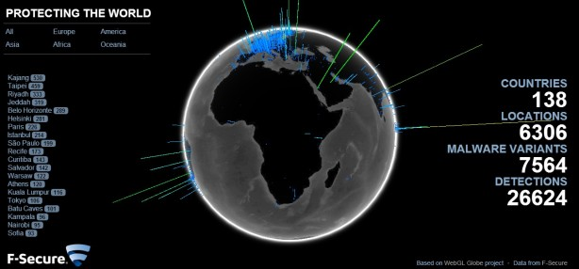
Future Plans
Our future plans for this website is to attain the ability to track the devices with changing IP address by using the last location of the device and the next location and noting the difference of the distance between following locations of the device and also using the time duration of the previous and the next IP address.

Slide 13
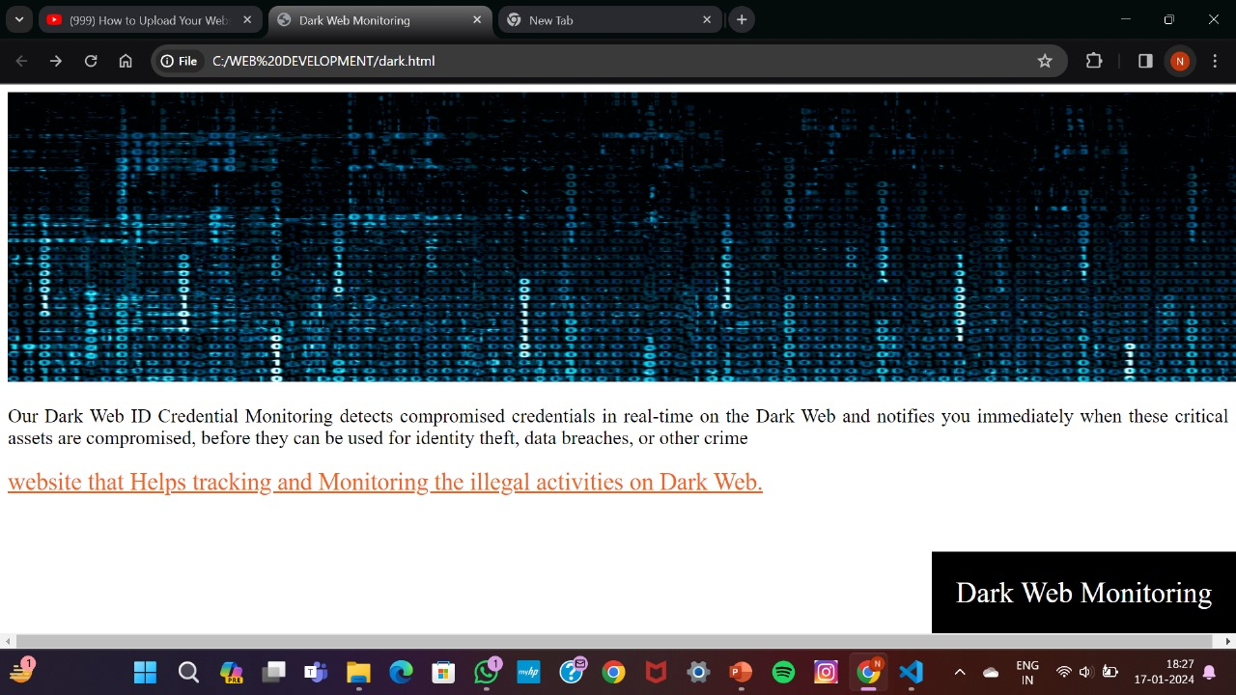
Sample Interface of “Pro-Tekk”

Slide 14

Code-O-Maniacs
vb6024727@gmail.com

Slide 15
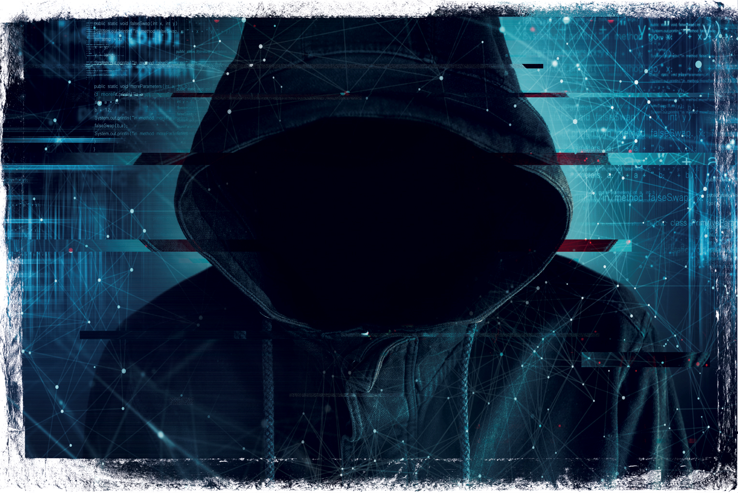
THANK YOU

